Slide 1
Animal Aerodynamics
Day 1

Slide 2
Can you match the pairs?
In your table groups, match the human-made structures and items with the animals and nature that inspired them.
Good luck!

Slide 3
What is biomimicry?
Biomimicry is an approach to innovation that seeks sustainable solutions to human challenges by emulating nature’s time-tested patterns and strategies.
https://biomimicry.org/what-is-biomimicry/

Slide 4
What is biomimicry?
Biomimicry is a way of copying what works in nature and using it to find solutions to the problems that humans face.

Slide 5
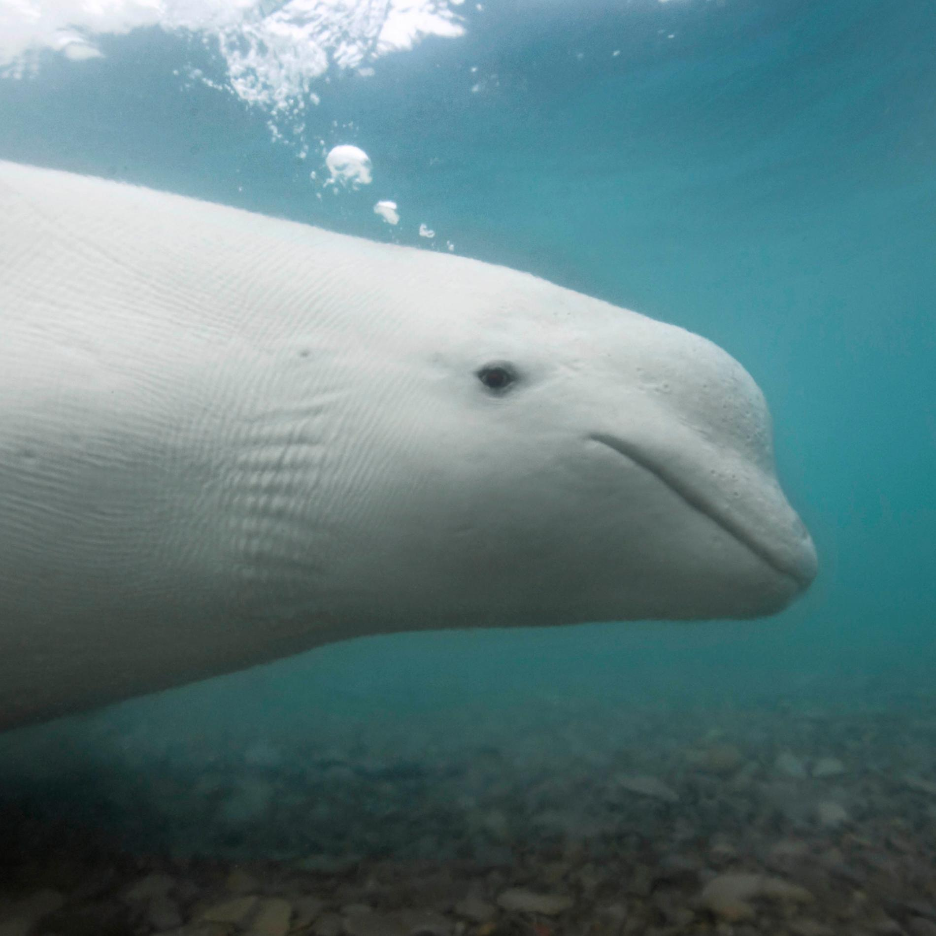
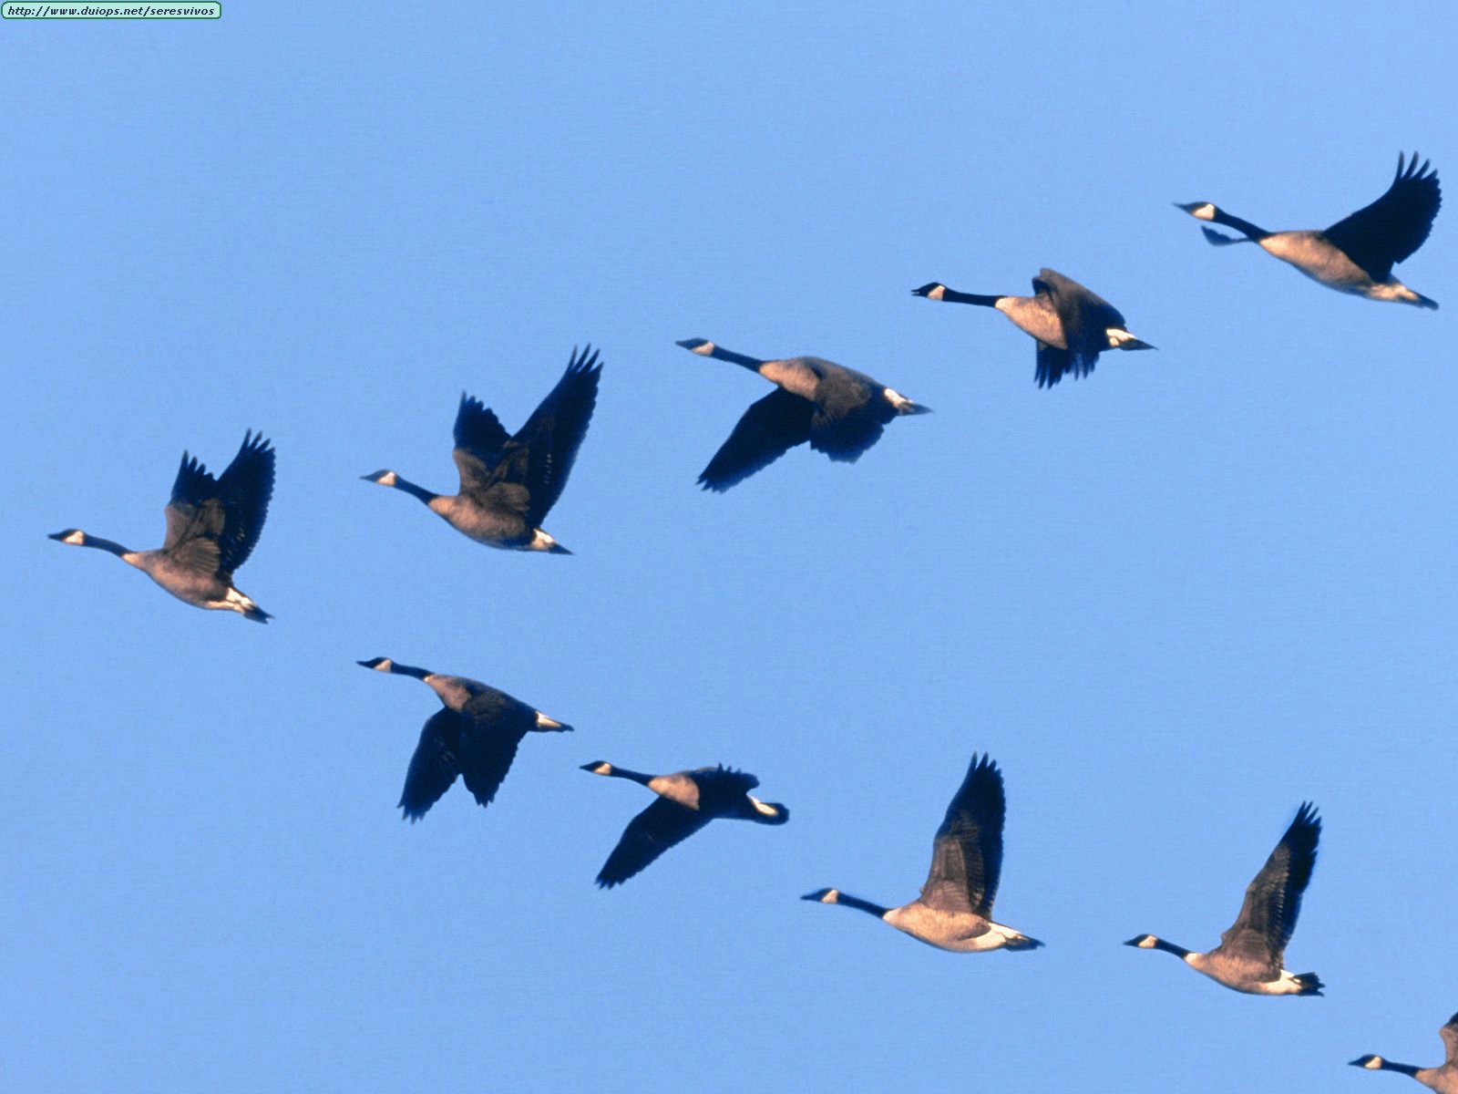
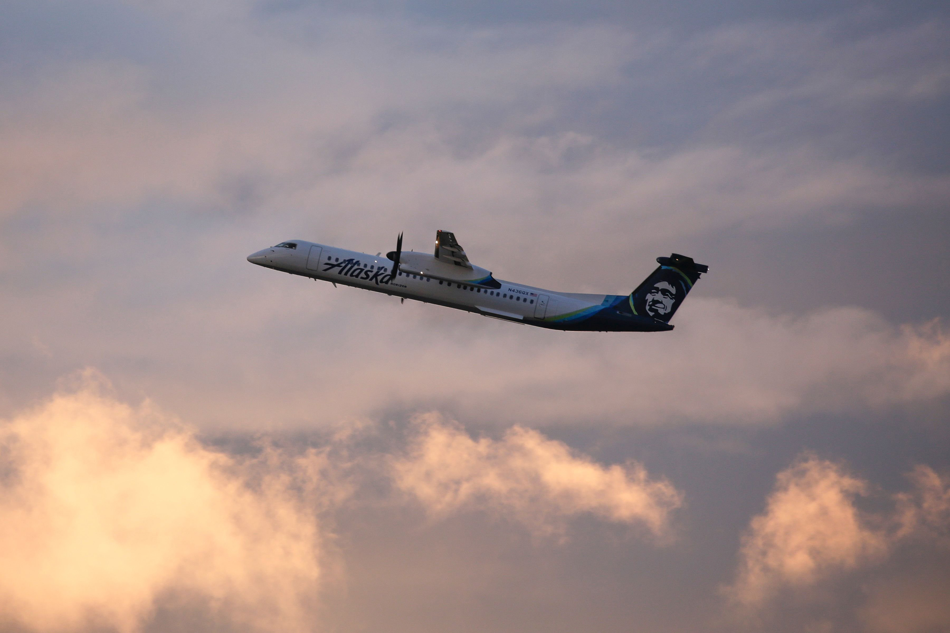
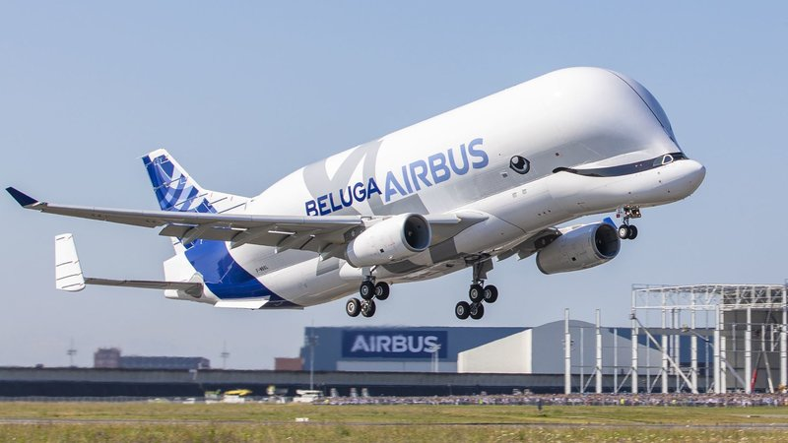
Can inspiration from nature change the way we travel?

Slide 6
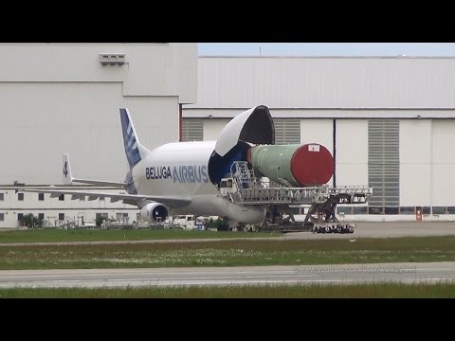
Loading the Airbus Beluga
Notes:
Show opening at the start of video, increase speed to 2x and skip to 1:09

Slide 7
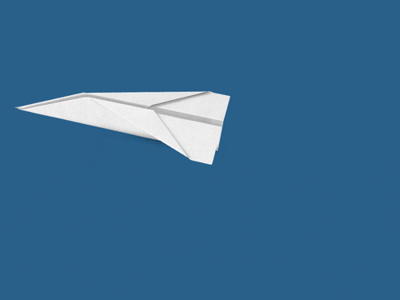
How do we make a plane?

Slide 8
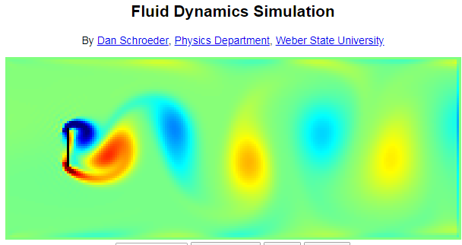

Slide 9
physics.weber.edu/schroeder/fluids/

Slide 10
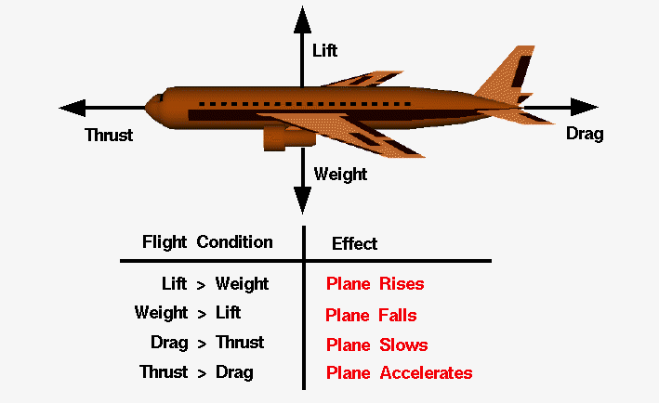
What do we need to know?

Slide 11
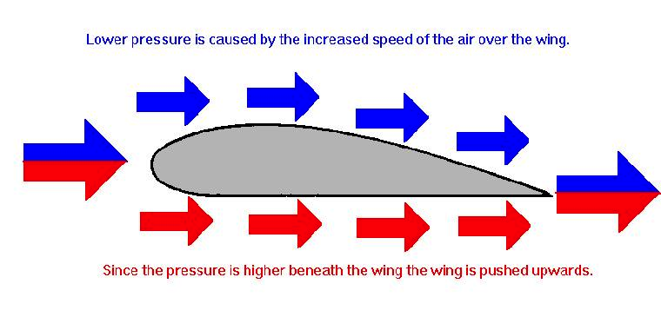
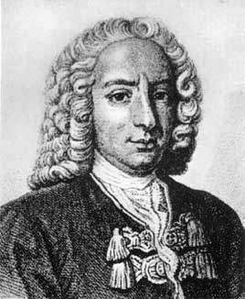
What do we need to know?

Slide 12
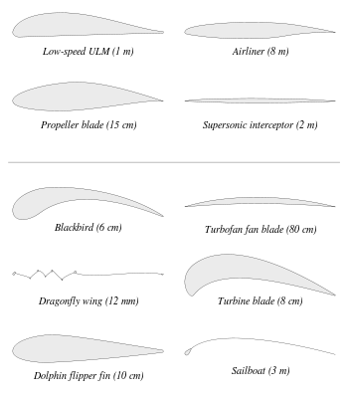

Slide 13
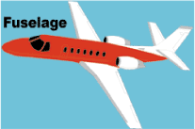
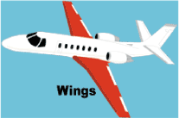
How do we make an
animal-inspired aircraft?
https://www.grc.nasa.gov/www/k-12/UEET/StudentSite/airplanes.html

Slide 14
How do we make an
animal-inspired aircraft?
Open these websites:
images.google.com
picsvg.com
designer.gravit.io (username: ####, password: ####)

Slide 16
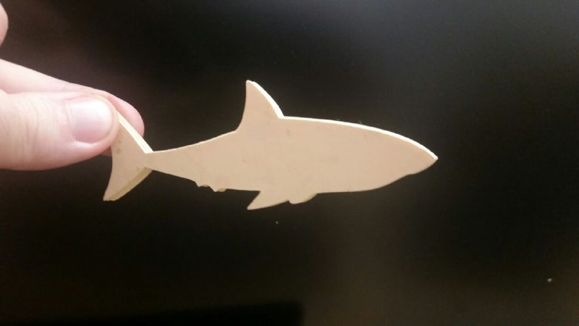

Slide 17
